Slide 1
Pirate PTO Meeting
Believe Dream Achieve

Slide 2
Thank you!!!
The Pirate PTO Board would like to sincerely thank our Veterans for their service and sacrifice.

Slide 3
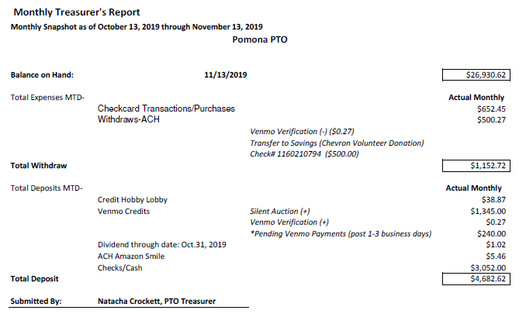
Treasury Report

Slide 4
Fall Carnival Recap
Fall Carnival Financial Snapshot (Monies Raised/Received)
Cakewalk | $352.00
Vendor Profit Sharing | $280.00
Games Sponsorships | $300.00
Silent Auction | $3,510.00
Total | $4,442.00
Pending Donations
Hillwood Communities Donation | $2,033.00
Grand Total *Includes Pending Transaction | $6,475.00

Slide 5
Fall Carnival Recap Continued…
Silent Auction & Game Sponsors:
Code Ninjas Pearland
J Headley Properties
The Way of Life Church—Pastor Chris Clemons
Sealed With Sugar
Houston Methodist Facial Plastic Surgery Specialists
Cake Walk Donors:
Tasha's Tasty Treats
Simply Sweets
East Texas Eats
Sugar Rush
Volunteer Report
Signup Genius—38 out 48 Time Slots Filled!!! (79.2% fill rate)
Pomona Teen Advisory Group
Manvel Jr. High – National Junior Honor Society

Slide 6
October Teacher Appreciation Event Recap
106 Items Donated!
54 Parents Donated!

Slide 7
Save-The-Dates
Holiday Shopping Date Out
December 7th
Time: 9 AM-1 PM
Fee: $25.00 per Child
Attire: Pajamas
Activities:
Games & Movies
Food & Beverages will be Provided
Christmas Student Store
December 3rd - 6th
^{Time: 10:30 AM-1:15 PM}
^{Items for Sale:}
picture frames, earrings, coffee mugs, gloves, socks, etc.
**Flyer will be sent home and communication given to teachers.
Gift of Time
December 9th – 18th
Volunteer Shifts: 1 hour and 15 minutes during lunch.
*Pre-K/K—December 10th
^{*1st Grade—December 11th}
*2nd Grade & Wings—December 12th
^{*3rd Grade—December 13th}
^{*4th Grade—December 16th}
^{*5th Grade—December 15th}
^{*SPED/Specials—December 18th}

Slide 8
Thank You!
Next Meeting :
January 23, 2020

