Slide 1
Welcome!!! Pirate PTO Virtual Meeting October 7, 2020

Slide 2
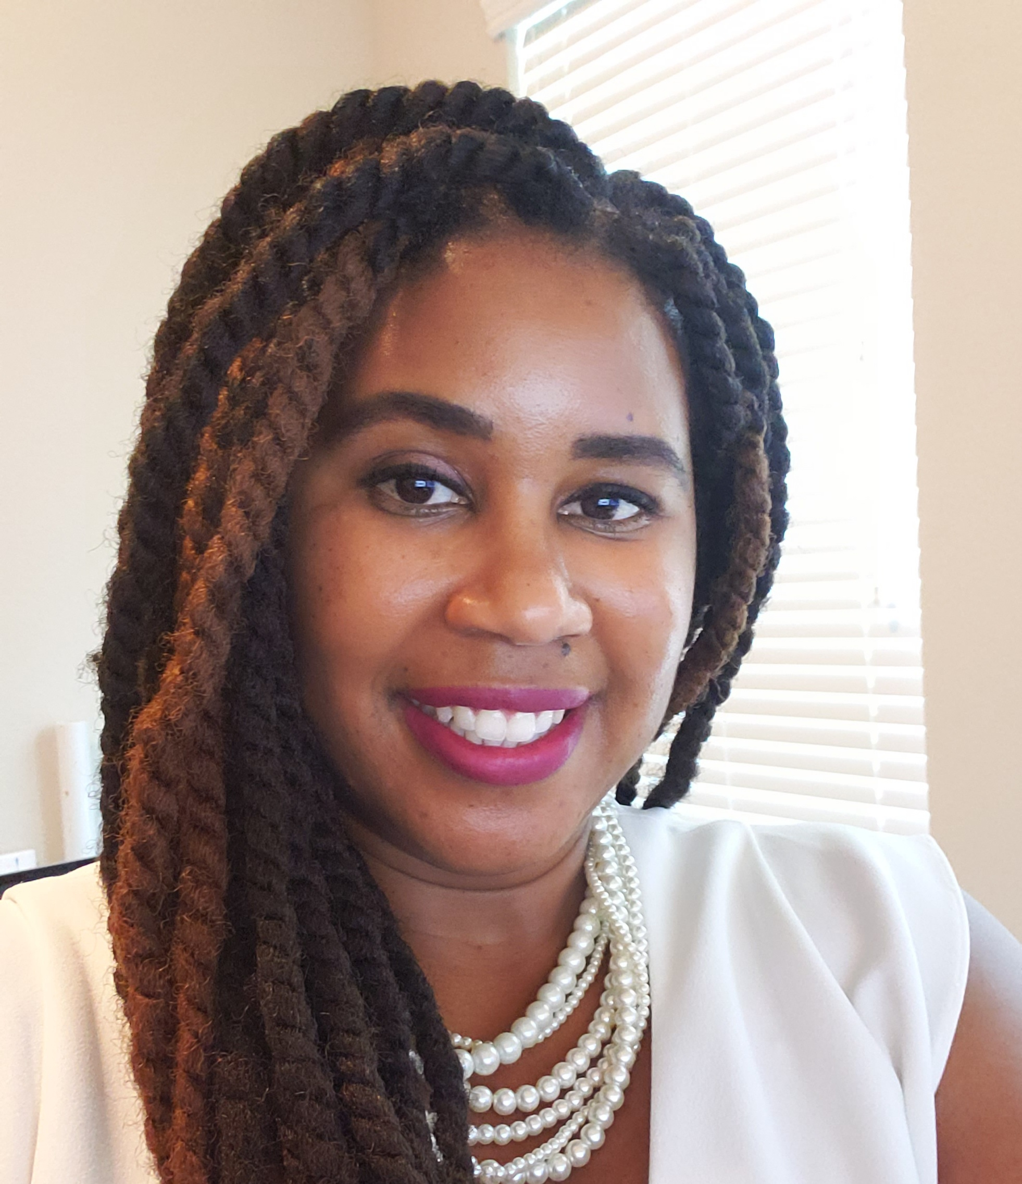
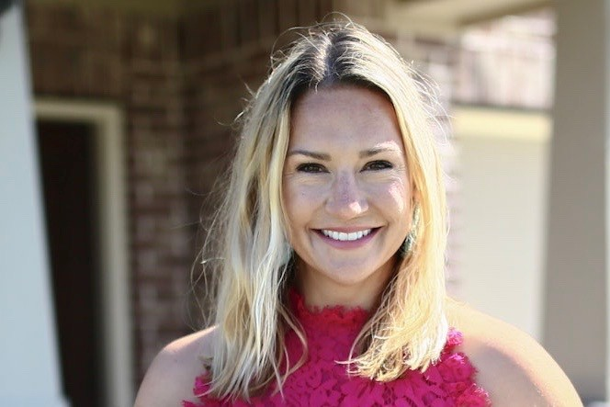
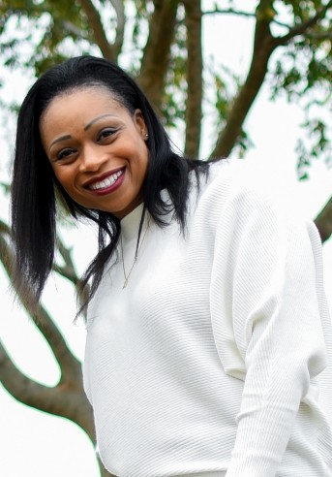
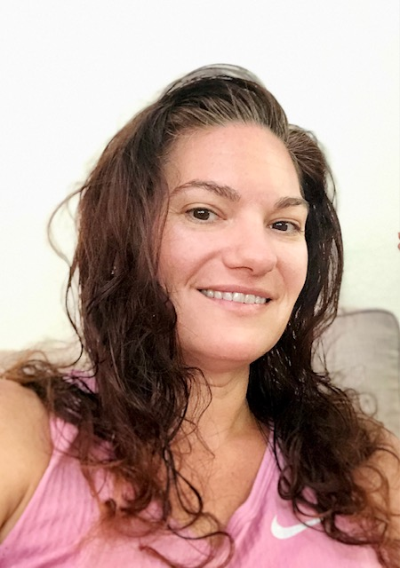
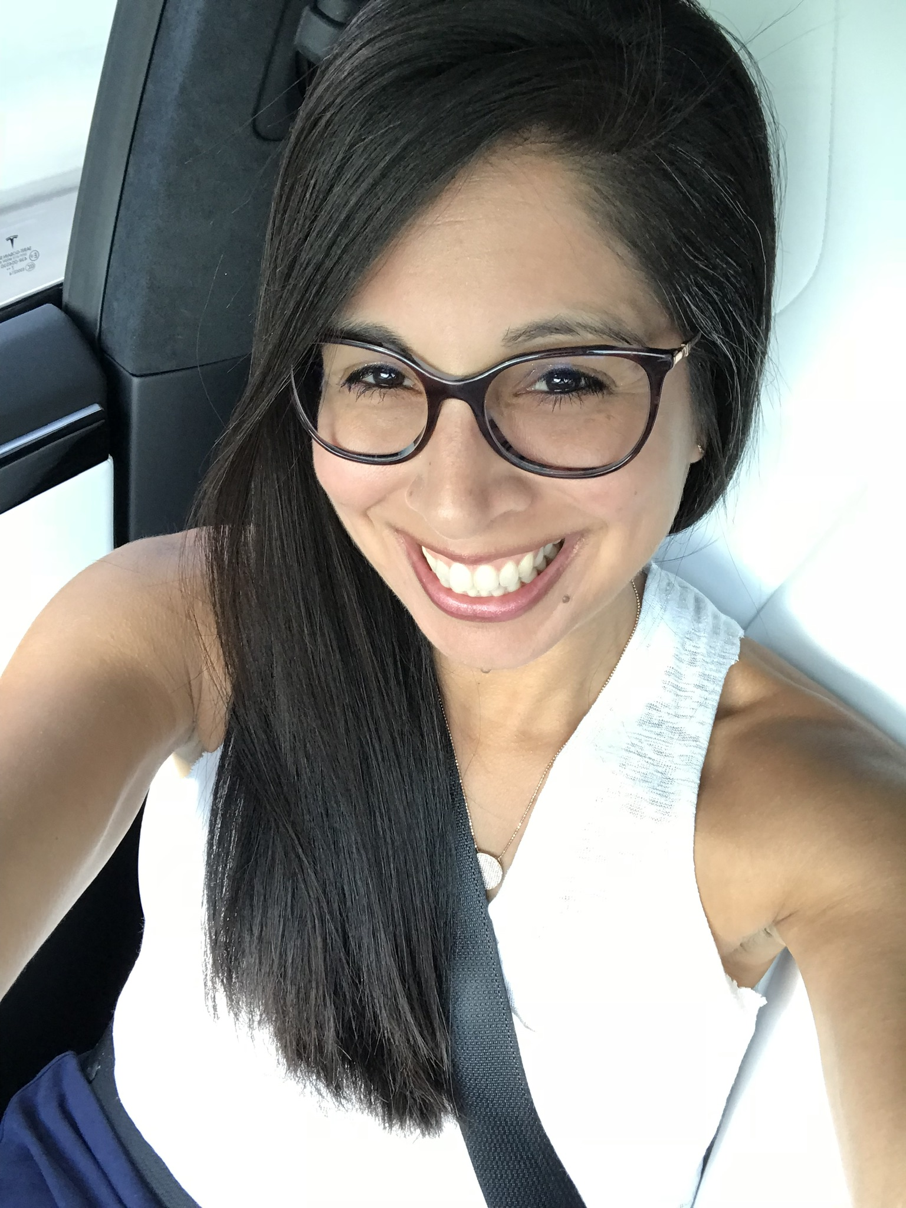
Meet the Pirate PTO Board 2019-2021
Stephanie Craddock President
Kristen McCoy
Vice President
Natacha Crockett Treasurer
Jennifer Bennett Secretary
Celina Rangel
Communications Chair

Slide 3
Pirate PTO 2019-2020 Snapshot

Slide 5
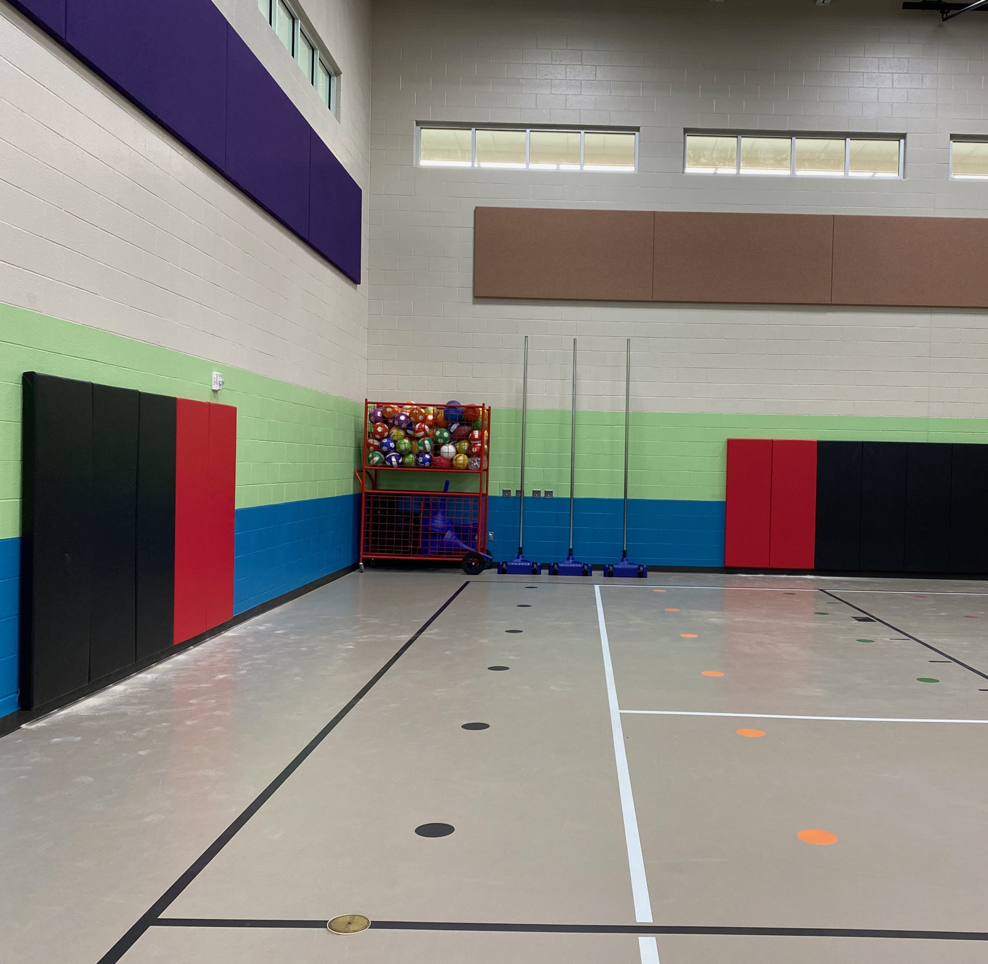
Gym Padding

Slide 6
Treasury Report Pirate PTO

Slide 7
Monthly Treasurer's Report
Monthly Snapshot as of September 7, 2020 -October 7, 2020
Pomona PTO
Balance on Hand: | 10/7/2020 |  | $5,283.96
Total Expenses MTD- |  |  | Actual Monthly
 | Withdraws-ACH | *QuickBooks OnliUSINT*QuickBooks | $42.64
Total Withdraw |  |  | $42.64
Total Deposits MTD- |  |  | Actual Monthly
 | Deposits | *VENMO-0 VENMO- * Memebership Dues | $210.00
 |  | Dividend Through date: 30SEP2020 | $0.04
Total Deposit |  |  | $210.04
Submitted By: | Natacha Crockett, PTO Treasurer

Slide 8
Exciting News from the Pirate PTO

Slide 9
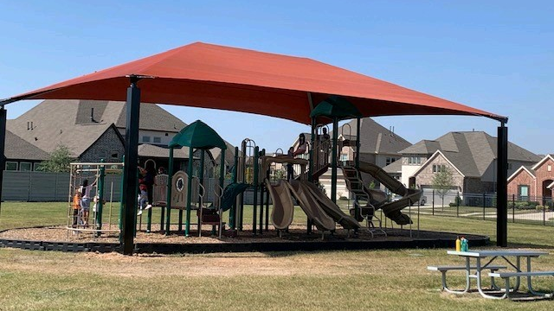
Playground Shade Installed

Slide 10
October is Teacher Appreciation Month

Slide 11
Thank you. We appreciate the support from our Pomona families!!

Slide 12
Pirate PTO Spirit Wear Fundraiser
$1,169 raised!!!
Spirit Wear Store will re-open in December.

Slide 13
Bidding Ends Thursday, October 8th @ 4 pm !!

Slide 14
Mark your Calendar: Key Dates
October 24th from 6:15 PM - 7:15 PM
Drive By Trick or Treating
October 26th - October 30th
Smallcakes Bakery Fundraiser
Families will remain in their vehicle during the drive-by and must wear masks.
Candy stations will be set-up along the designated route. Candy will be dropped into your child’s treat bag/container.
Volunteers will be stationed at decorated tables 6-10 feet apart. Volunteers will be wearing masks and gloves.

Slide 15
PTO Membership Drive Please Join !!
https://docs.google.com/forms/d/e/1FAIpQLSehoMAVt468rDrGT3UudB9VF8saPMIuKpeoNuGBrWfeLv3Z_w/viewform

Slide 16
Holiday Drive-In Movie Event December 4th

Slide 17
Thank You

