Slide 1

Welcome!!!
Pirate PTO Virtual Meeting
January 28, 2021

Slide 2
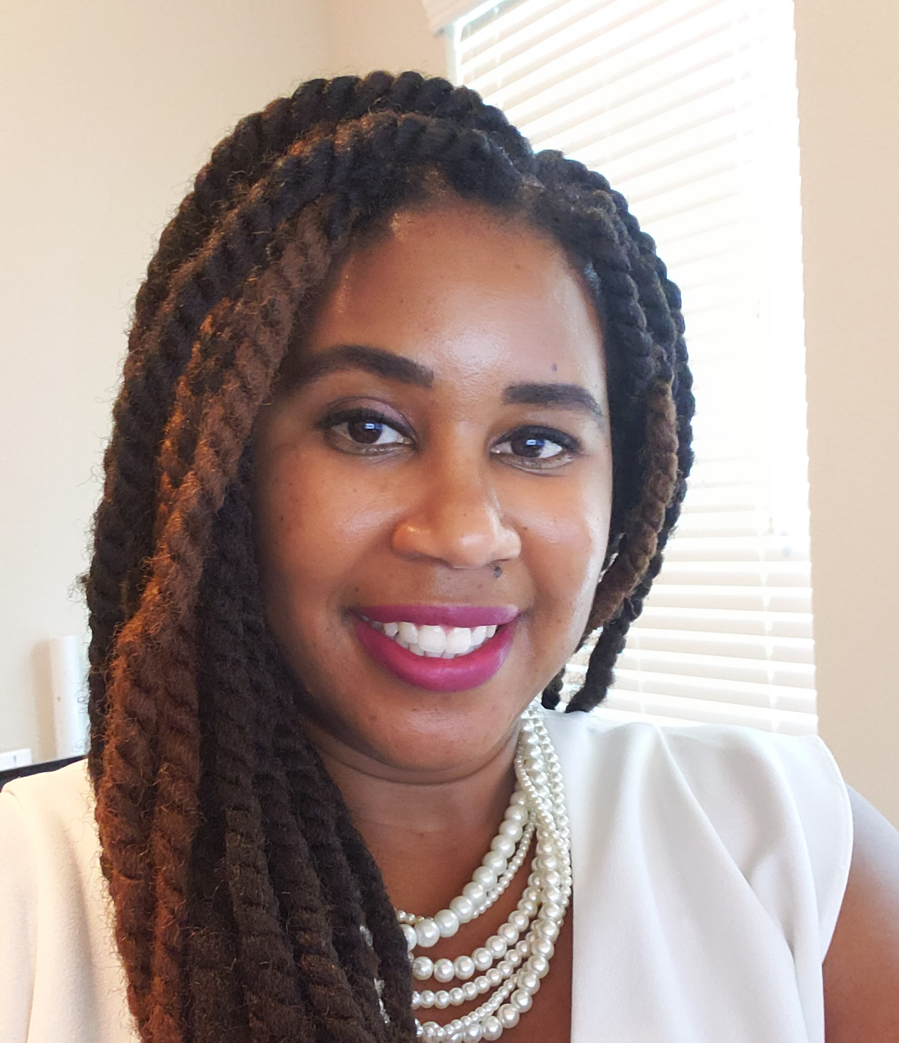
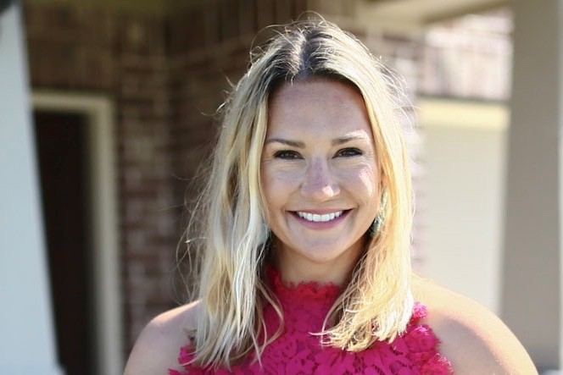
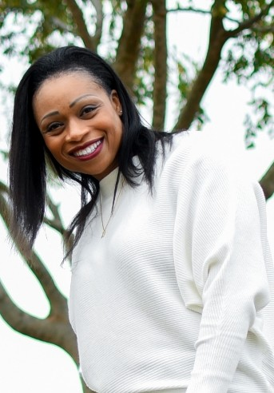
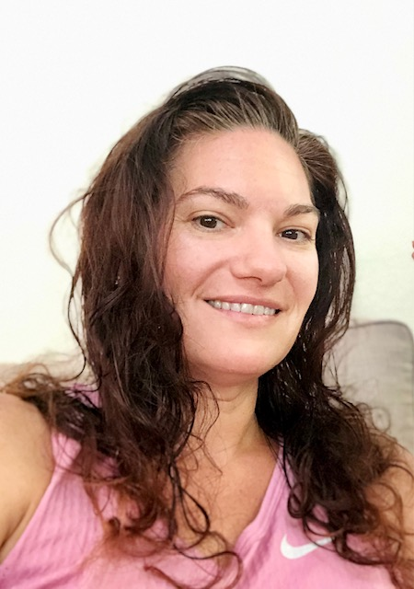
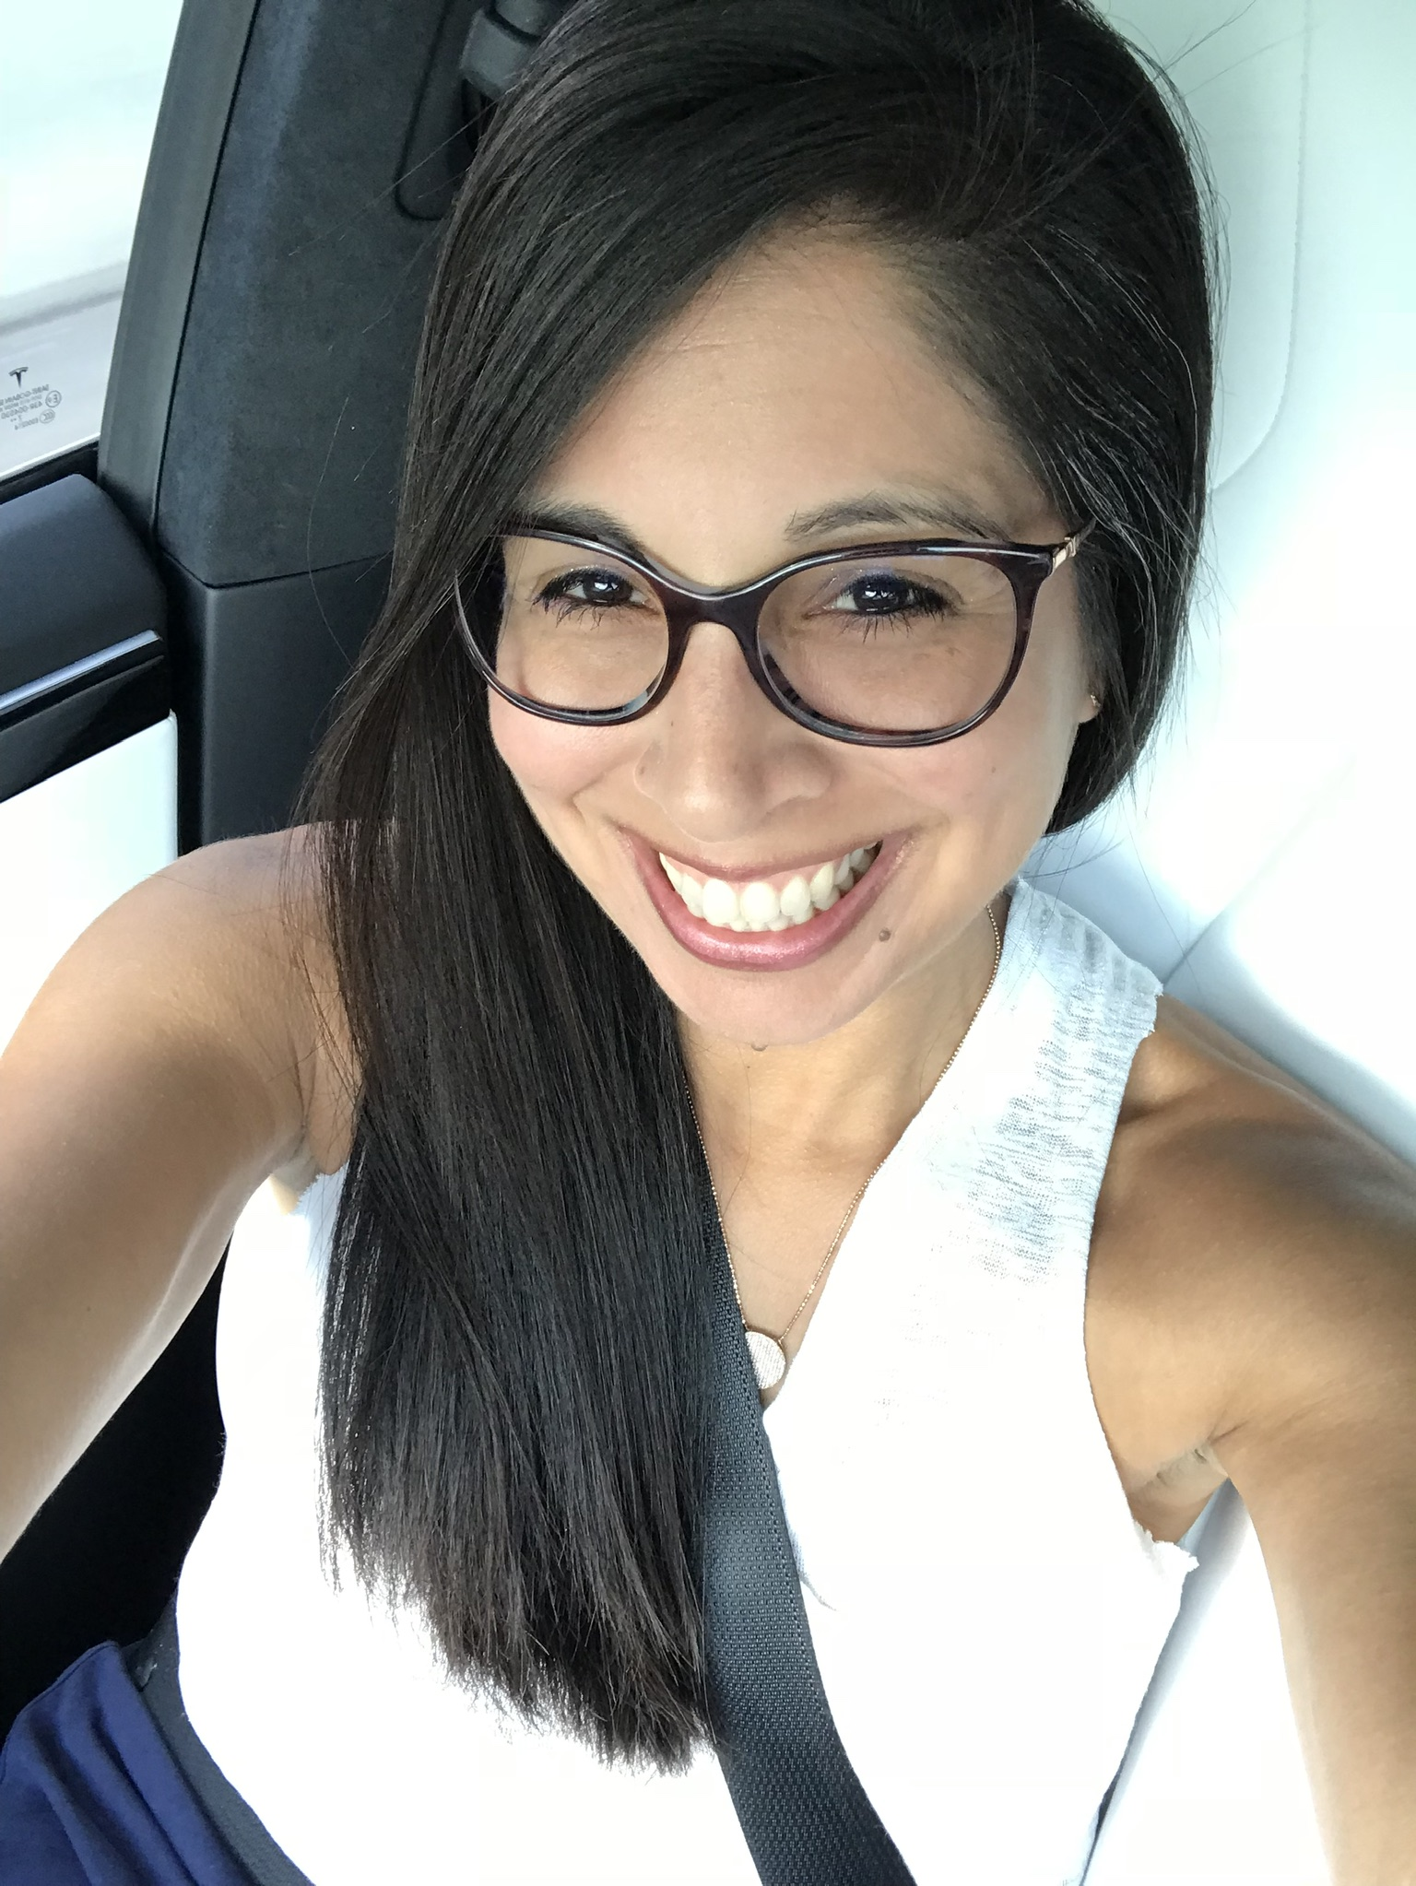
Meet the Pirate PTO Board
2019-2021
Kristen McCoy
Vice President
Stephanie Craddock President
Natacha Crockett Treasurer
Jennifer Bennett
Treasurer
Celina Rangel
Communications Chair

Slide 3
Pirate PTO
Fall Recap

Slide 4
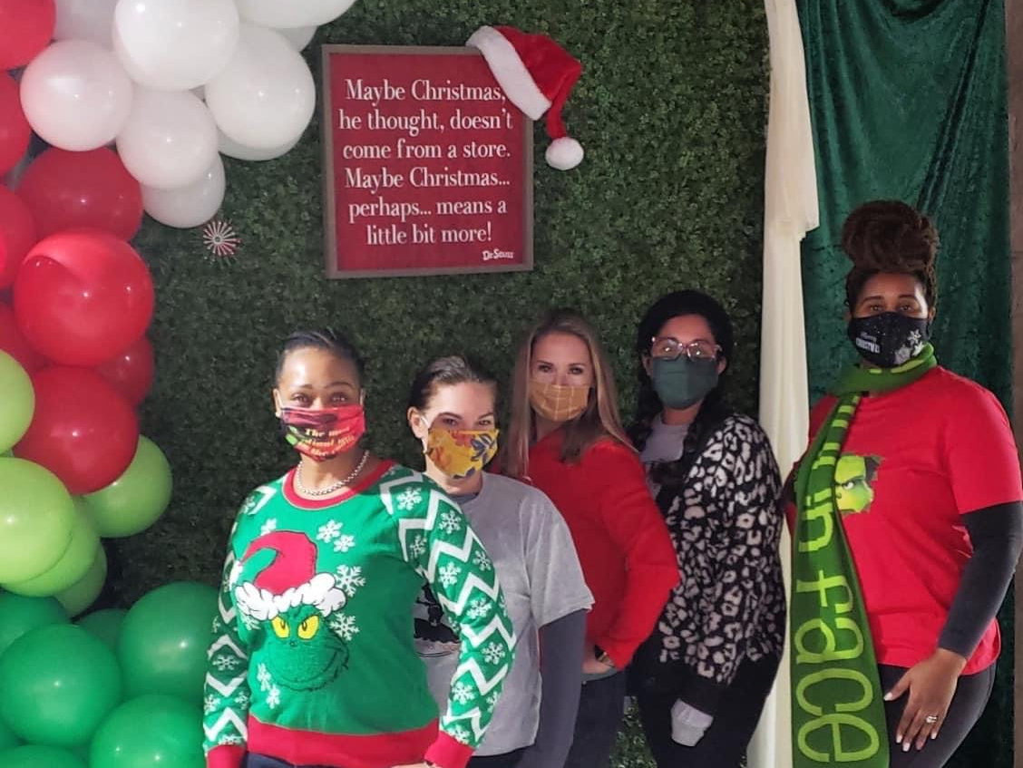
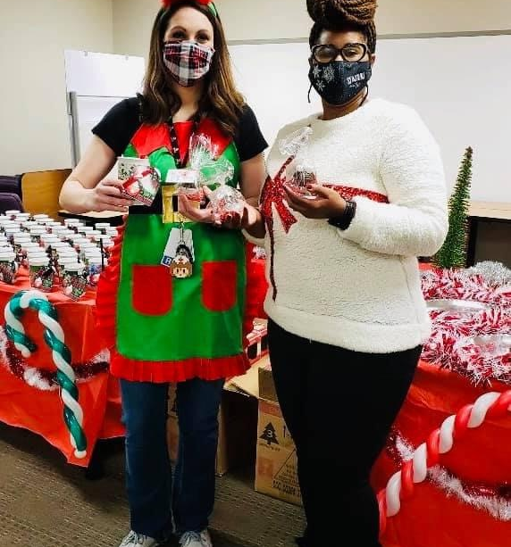
Notes:
PTO sponsored events since the last time we met:
1. First Annual Member Appreciation Holiday Drive-In Movie
-Viewed The Grinch
- Replaced Karoke Night in previous year
2. December Teacher and Staff Appreciation
- Cocoa Bombs

Slide 5
Treasurer Report
Monthly Treasurer's Report
Monthly Snapshot as of December 28. 2020- January 28, 2021
Pomona PTO
Balance on Hand: | 1/28/2021 |  | $8,331.97
Total Expenses MTD- |  |  | Actual Monthly
 | Withdraws-ACH | QuickBooks OnliUSINT | $42.64
Total Withdraw |  |  | $42.64
Total Deposits MTD- |  |  | Actual Monthly
Total Deposit |  |  | $0.00
Submitted By: | Natacha Crockett, PTO Treasurer
Notes:
INSERT FLYER

Slide 6
Pirate PTO
Current Events

Slide 7

LAST DAY TO ORDER:
February 5th
Pirate PTO
Spirit Wear Store
Notes:
DEADLINE Extended to February 5th
Students will be encouraged to wear Spirit Wear during Dance Fit on Friday, March 12th

Slide 8

February 1st-5th
Donation Drop-Off at School Entrances
Notes:
Sign-Up Genius open now
Drop-Off donations at each entrance to school next week. February 1st-5th.
Bins will be decorated at each drop-off location for students to leave donations.
Lounges will be stocked for teachers and staff on Monday, February 8th.

Slide 9
Upcoming Events

Slide 10

Dance Fit
February 10th - Registration Starts
February 19^{th -} Pep Rally Kick-Off
^{March 12th - DANCE FIT}
Notes:
CLICK SLIDE TO PLAY VIDEO
BIGGEST FUNDRAISER
Last year canceled due to shut down.
Fund will be used to purchase new Technology for classrooms (laptops, iPads, etc)

Slide 11

SAVE-THE-DATE
General Meeting and
2021-2023 Officer Elections
Thursday, April 22nd
Notes:
Board Testimonials
All working parents

Slide 12

2021-2023
PTO Board Positions
President
Vice President
Treasurer
Secretary
Communications Chair
EMAIL: piratePTO@pirateportal.org
Notes:
Current Board all working Moms
Would love for Dads to be represented on Board, too.
Email us if interested
Can set-up call to address any questions/concerns

Slide 13

Thank You

