Slide 1
Welcome!!! Pirate PTO Virtual Meeting & Elections April 29 , 2021

Slide 2
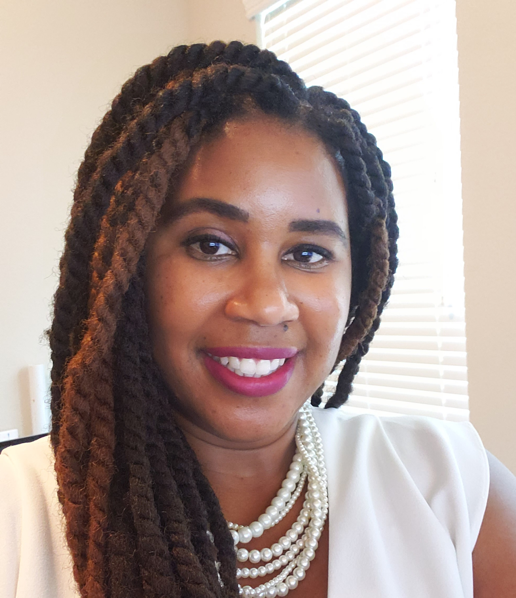
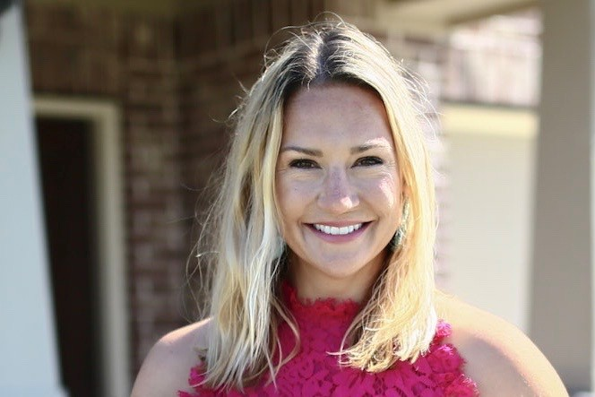
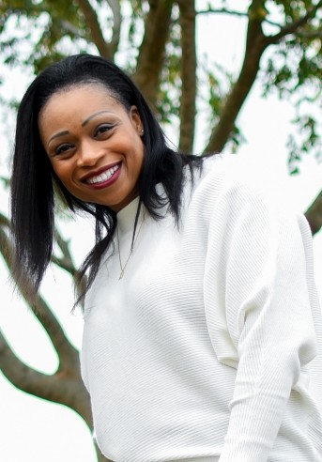
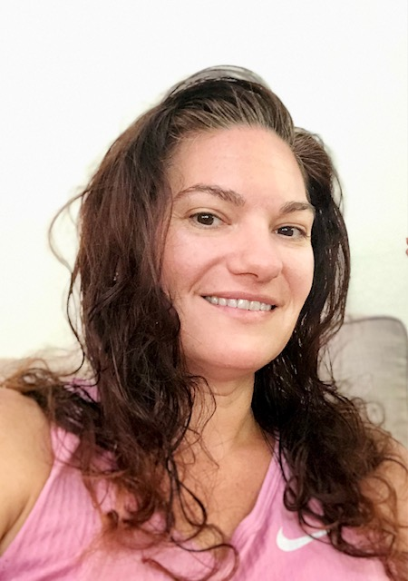
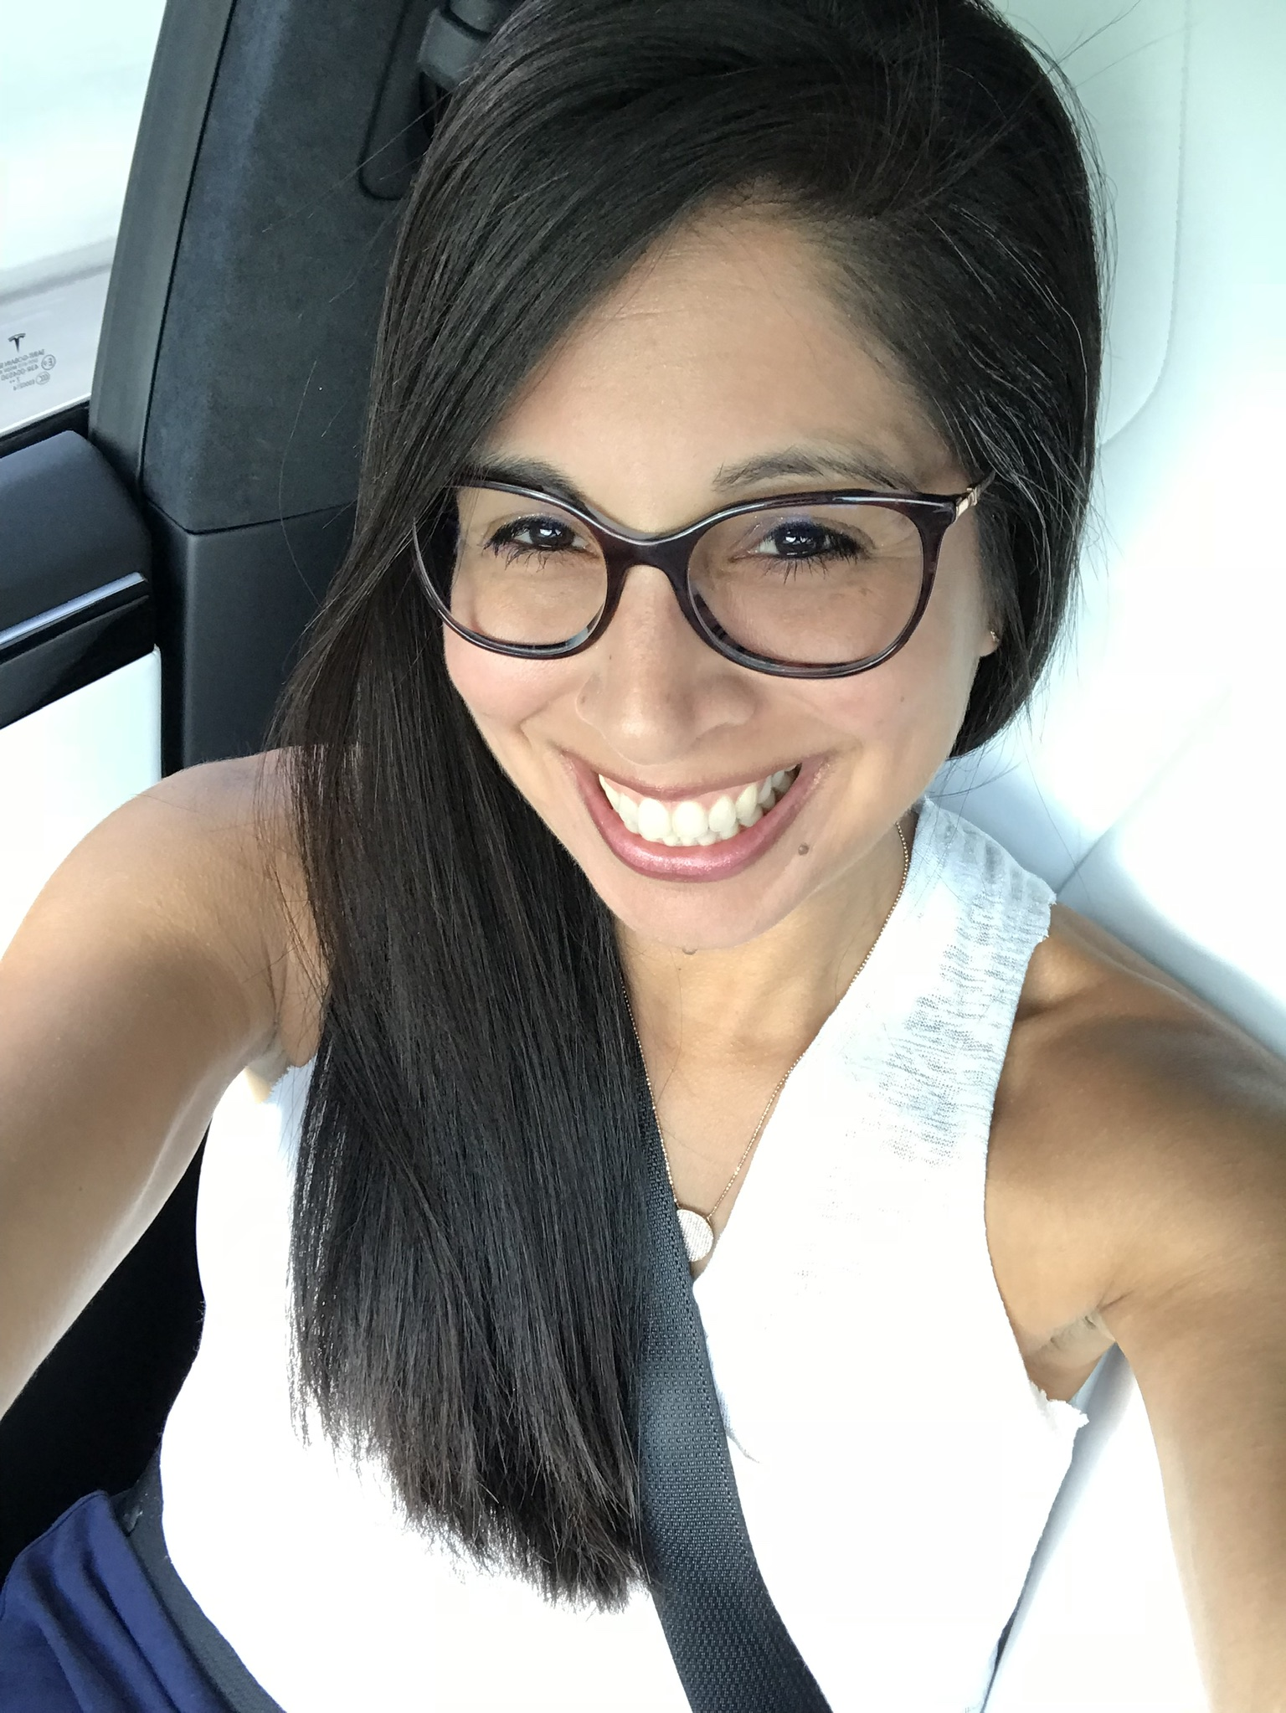
Pirate PTO Board 2019-2021
Kristen McCoy
Vice President
Stephanie Craddock
President
Natacha Crockett Treasurer
Jennifer Bennett
Secretary
Celina Rangel
Communications Chair

Slide 3
Pirate PTO Spring Recap

Slide 4
Stock-The-Fridge Recap Date: Feb. 8th, 2021 27 Families donated snacks & goodies for our faculty! Thank you!

Slide 5
We hoped parents enjoyed the convenience of ordering apparel online & getting orders shipped directly to their homes.
Pirate PTO Spirit Wear Store
Notes:
DEADLINE Extended to February 5th
Students will be encouraged to wear Spirit Wear during Dance Fit on Friday, March 12th

Slide 6
Mission Accomplished
We raised $17,740.01 during our Boosterthon!

Slide 7
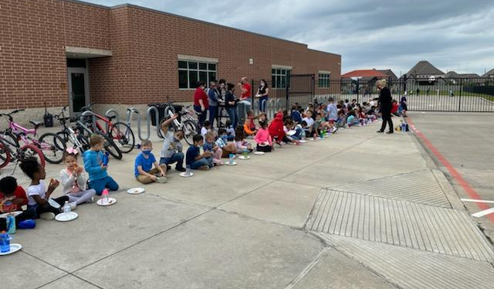
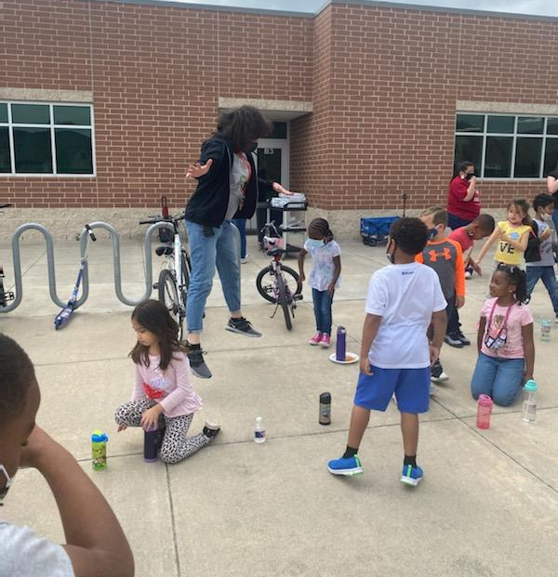
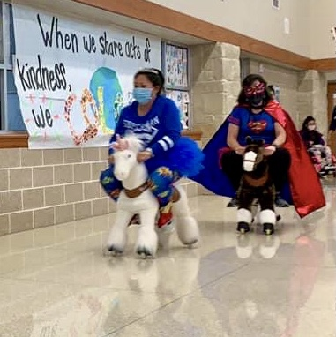
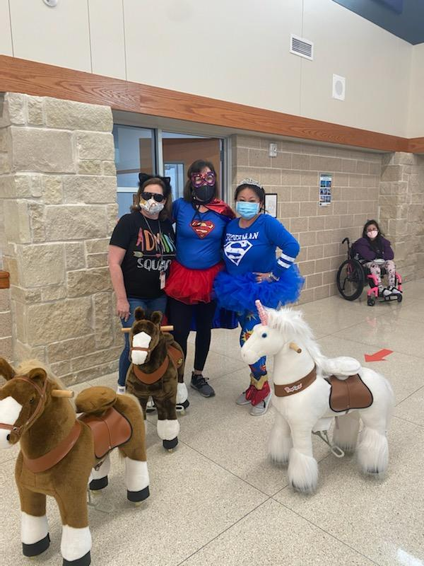
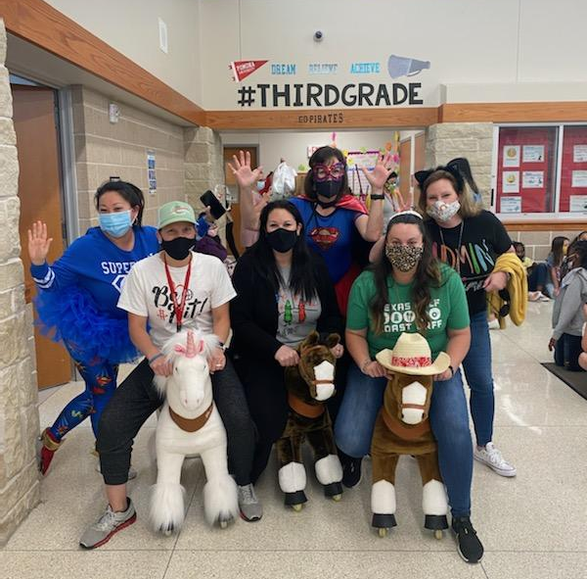
Dance Fit
Memories !!

Slide 8
216 shields purchased for our students because of your fundraising efforts!!
Thank you, parents!

Slide 9
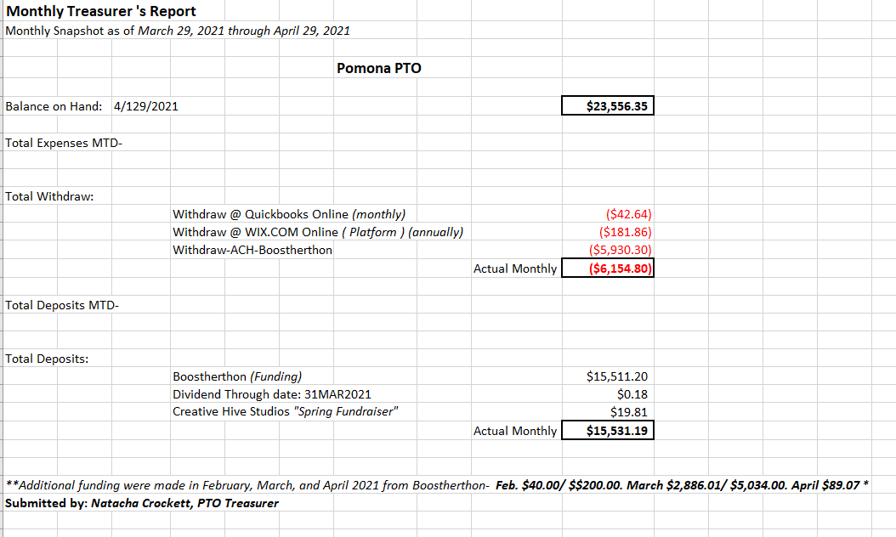
Treasurer Report
Notes:
INSERT FLYER

Slide 10
Upcoming Events

Slide 11
April Staff Appreciation Event
Please Do Not Forget!
Though we will not be together to celebrate, let our fantastic Pomona Teachers & Staff know how much they mean to you.
Let’s show how sweet they are with homemade signs!
Sign drop off: April 26th – April 30th AM

Slide 12
MAY 3RD- 7^{th!!}

Slide 14
Pirate PTO Board 2021-2023 Candidates
President
Kristen McCoy
Vice President
Tyne` Mattox
Treasurer
Kara Ihedigbo
Secretary
DeAngel Bonilla
Communications Secretary
Hilary Bruton
Notes:
Current Board all working Moms
Would love for Dads to be represented on Board, too.
Email us if interested
Can set-up call to address any questions/concerns

Slide 15
Thank You

